Slide 1

Static & Dynamic web pages, Servlet and JSP
<number>

Slide 2


Course : Backend
Lecture On : Static & Dynamic web pages, Servlet and JSP
Instructor : Rahul Kumar
23/05/19
<number>

Slide 3
Today’s Agenda
Static and Dynamic web pages
Servlet
JSP
Maven
23/05/19
<number>

Slide 4
Static and Dynamic web pages
Static Web pages:
Static Web pages are very simple. It is written in languages such as HTML, JavaScript, CSS, etc.
For static web pages when a server receives a request for a web page, then the server sends the response to the client without doing any additional process. T
hese web pages are seen through a web browser.
In static web pages, Pages will remain the same until someone changes it manually.
Static web pages are called websites
Dynamic Web Pages:
Dynamic Web Pages are written in languages such as CGI, AJAX, ASP, ASP.NET, etc.
In dynamic web pages, the Content of pages is different for different visitors.
It takes more time to load than the static web page.
Dynamic web pages are used where the information is changed frequently, for example, stock prices, weather information, etc.
Dynamic web pages are called web applications
<number>

Slide 5
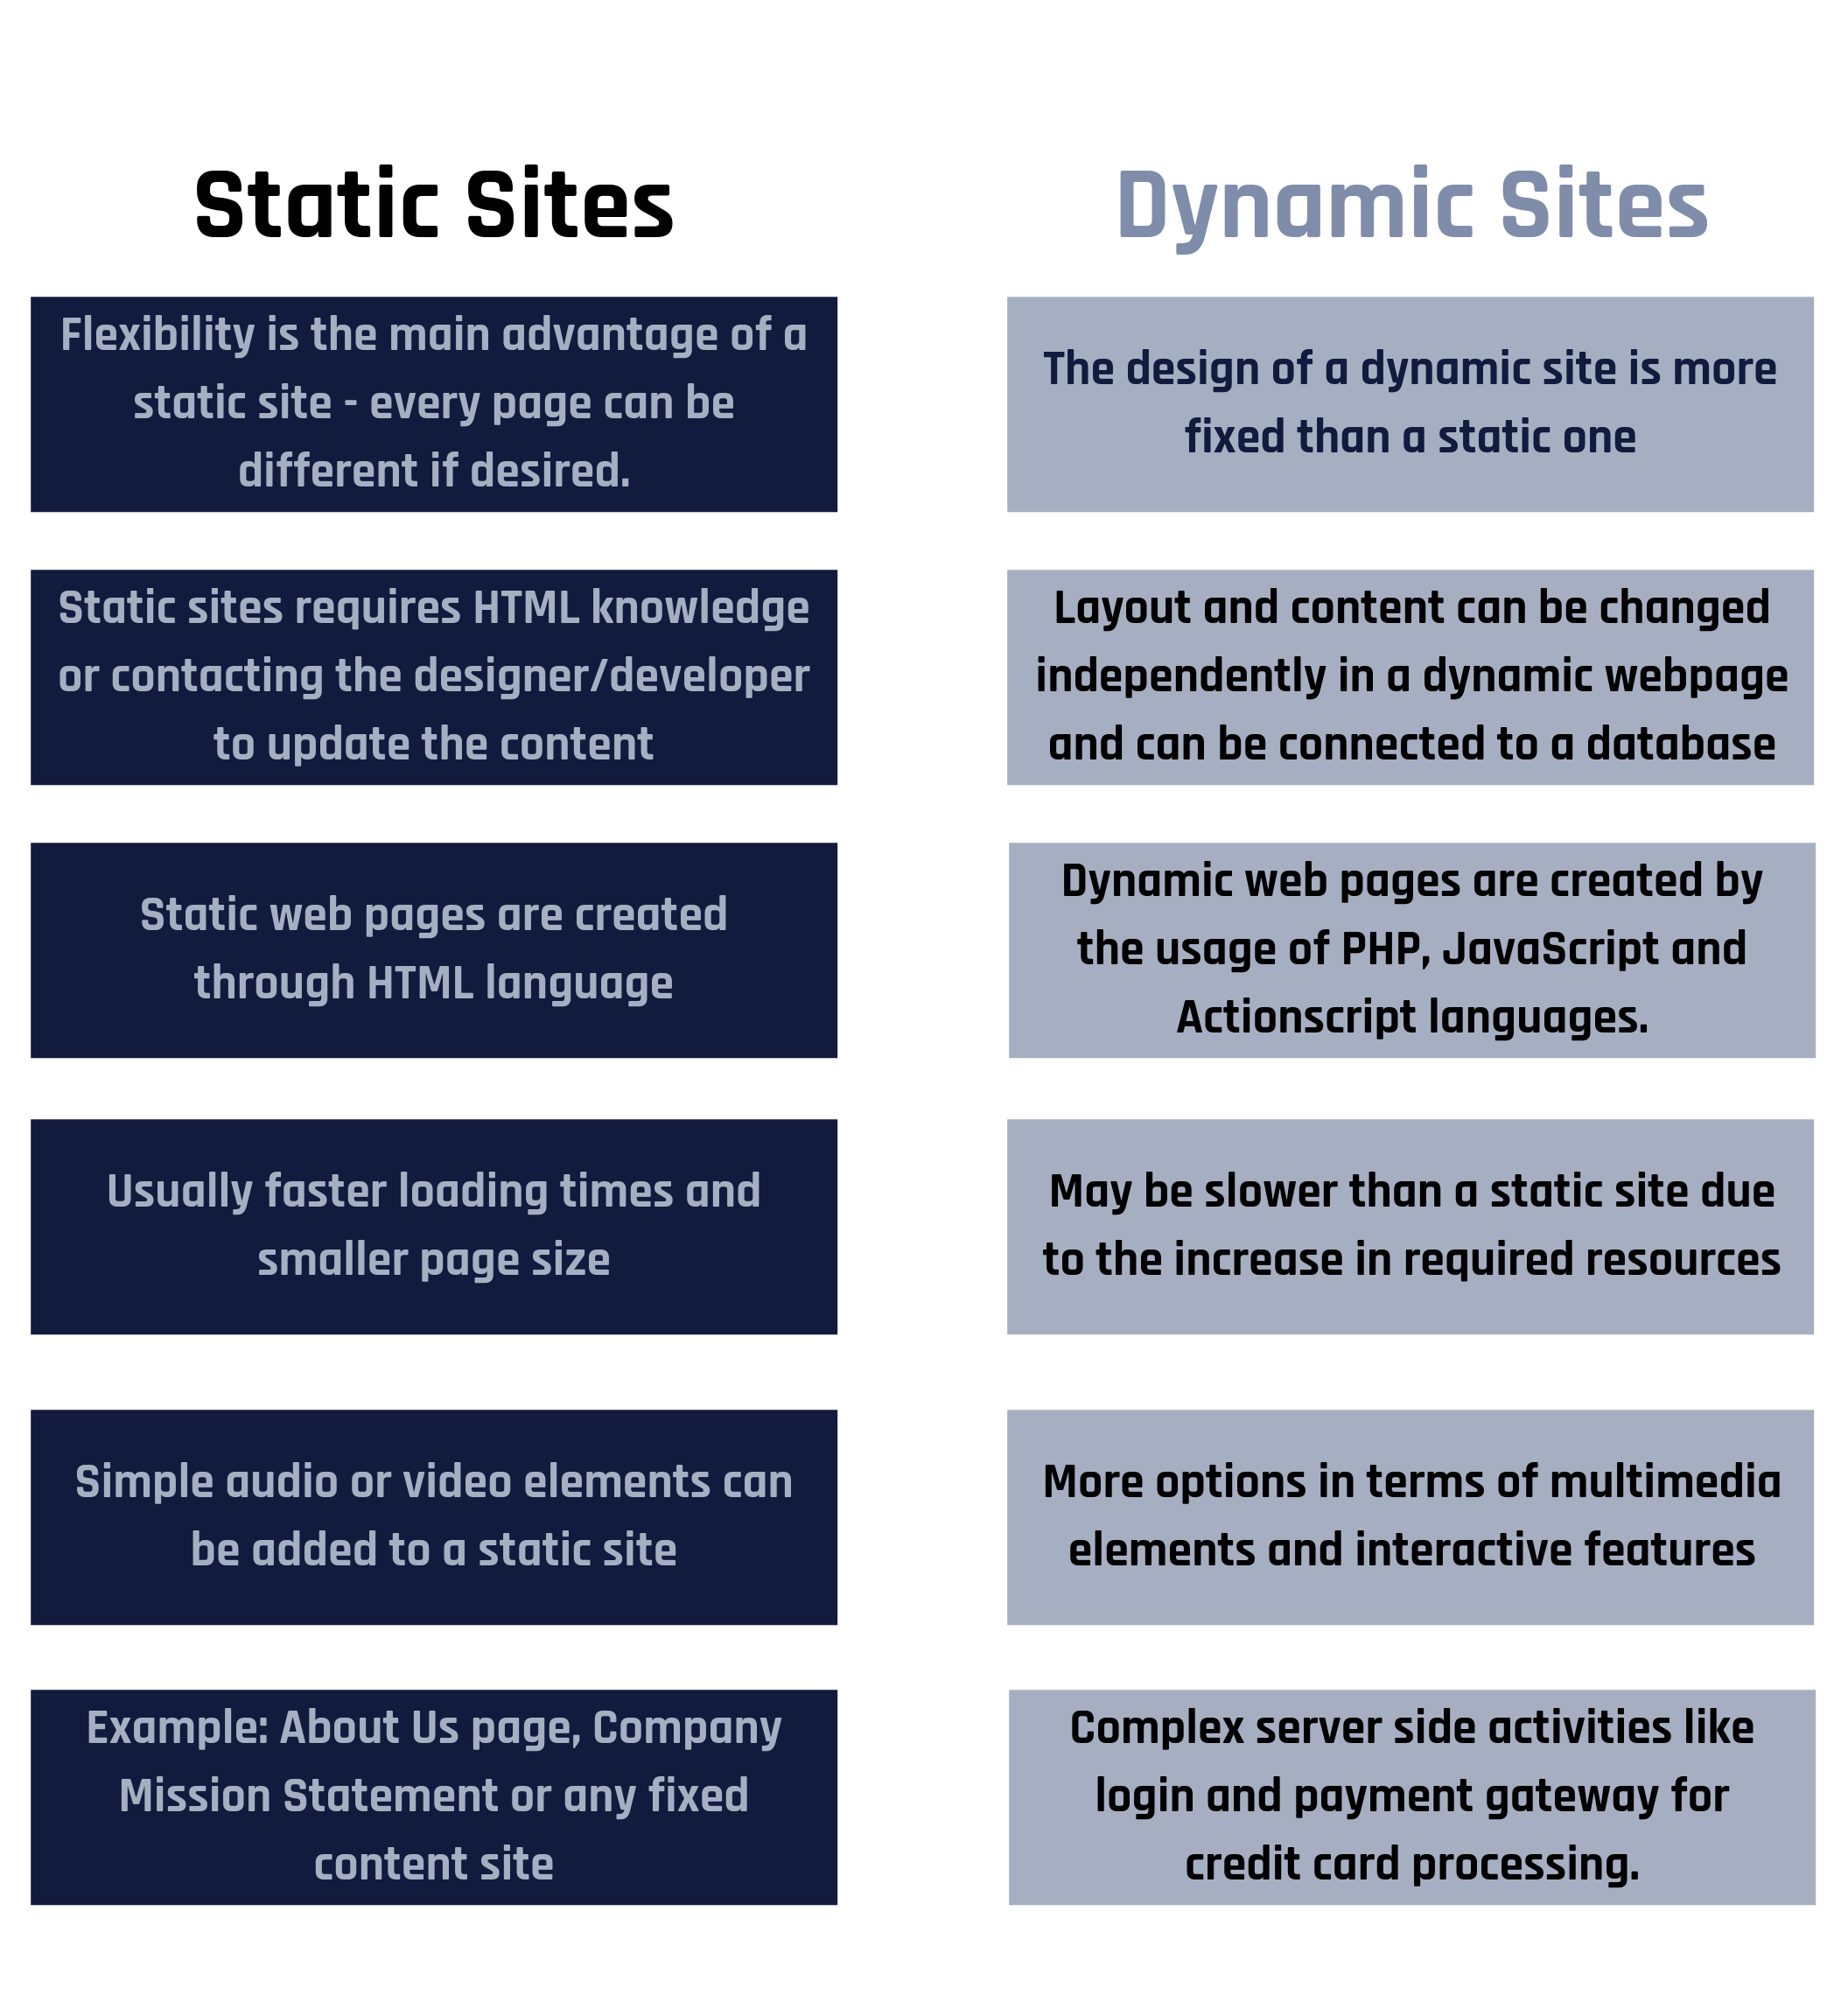
Static and Dynamic web pages
<number>

Slide 6
What is Servlet?
A servlet is a Java programming language class that is used to extend the capabilities of servers that host applications accessed by means of a request-response programming model.
Although servlets can respond to any type of request, they are commonly used to extend the applications hosted by web servers.
For such applications, Java Servlet technology defines HTTP-specific servlet classes.
The javax.servlet and javax.servlet.http packages provide interfaces and classes for writing servlets.
All servlets must implement the Servlet interface, which defines life-cycle methods.
When implementing a generic service, you can use or extend the GenericServlet class provided with the Java Servlet API.
The HttpServlet class provides methods, such as doGet and doPost, for handling HTTP-specific services.
<number>

Slide 7
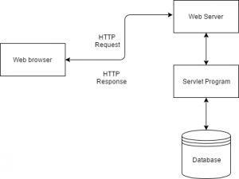
Execution of Servlet
Execution of Servlets involves six basic steps:
The clients send the request to the web server.
The web server receives the request.
The web server passes the request to the corresponding servlet.
The servlet processes the request and generates the response in the form of output.
The servlet sends the response back to the web server.
The web server sends the response back to the client and the client browser displays it on the screen.
<number>

Slide 8
What was the need of Servlet
The Servlet technology is similar to other Web server extensions such as Common Gateway Interface(CGI) scripts and Hypertext Preprocessor (PHP). However, Java Servlets are more acceptable since they solve the limitations of CGI such as low performance and low degree scalability.
<number>

Slide 9
What is CGI and its drawback?
CGI is actually an external application which is written by using any of the programming languages like C or C++ and this is responsible for processing client requests and generating dynamic content.
In CGI application, when a client makes a request to access dynamic Web pages, the Web server performs the following operations :
It first locates the requested web page i.e the required CGI application using URL.
It then creates a new process to service the client’s request.
Invokes the CGI application within the process and passes the request information to the server.
Collects the response from CGI application.
Destroys the process, prepares the HTTP response and sends it to the client.
<number>

Slide 10
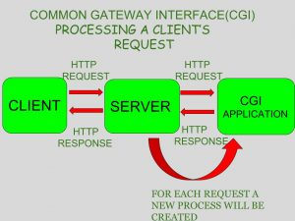
What is CGI and its drawback?
So, in CGI server has to create and destroy the process for every request. It’s easy to understand that this approach is applicable for handling few clients but as the number of clients increases, the workload on the server increases and so the time taken to process requests increases.
<number>

Slide 11
Advantages of Java Servlet
Advantages of a Java Servlet
Servlet is faster than CGI as it doesn’t involve the creation of a new process for every new request received.
Servlets as written in Java are platform independent.
Removes the overhead of creating a new process for each request as Servlet doesn’t run in a separate process. There is only a single instance which handles all requests concurrently. This also saves the memory and allows a Servlet to easily manage client state.
It is a server-side component, so Servlet inherits the security provided by the Web server.
The API designed for Java Servlet automatically acquires the advantages of Java platform such as platform independent and portability. In addition, it obviously can use the wide range of APIs created on Java platform such as JDBC to access the database.
<number>

Slide 12
The Servlet container
A servlet is a class that you will use to receive HTTP requests as methods and reply back with stuff (usually HTML).
A servlet container is a server program which provides everything else; the opening of the socket, the transformation framework to turn HTTP into Java API calls, and a number of interfaces which allow you to plug in your servlet code.
If it were an electrical outlet, the servlet container would be the socket in the wall, and the servlet would be the plug and cord that attaches to the socket; but, Java used a 'container' analogy. The servlet container is the "bucket" you put your servlet stuff into.
<number>

Slide 13
The Servlet container
Servlet container, also known as Servlet engine is an integrated set of objects that provide run time environment for Java Servlet components.
In simple words, it is a system that manages Java Servlet components on top of the Web server to handle the Web client requests.
Services provided by the Servlet container :
Network Services : Loads a Servlet class. The loading may be from a local file system, a remote file system or other network services. The Servlet container provides the network services over which the request and response are sent.
Decode and Encode MIME based messages : Provides the service of decoding and encoding MIME-based messages.
Manage Servlet container : Manages the lifecycle of a Servlet.
<number>

Slide 14
The Servlet container
Resource management : Manages the static and dynamic resources, such as HTML files, Servlets and JSP pages.
Security Service : Handles authorization and authentication of resource access.
Session Management : Maintains a session by appending a session ID to the URL path.
<number>

Slide 15
Introduction to Maven
Apache Maven is a software project management and comprehension tool. Based on the concept of a project object model (POM), Maven can manage a project's build, reporting and documentation from a central piece of information.
Why and how Maven project started?
Maven, a Yiddish word meaning accumulator of knowledge, began as an attempt to simplify the build processes in the Jakarta Turbine project.
There were several projects, each with their own Ant build files, that were all slightly different. JARs were checked into CVS.
Jakarta project team wanted a standard way to build the projects, a clear definition of what the project consisted of, an easy way to publish project information, and a way to share JARs across several projects.
Maven’s objectives
Maven’s primary goal is to allow a developer to comprehend the complete state of a development effort in the shortest period of time. In order to attain this goal, Maven deals with several areas of concern:
Making the build process easy
Providing a uniform build system
Providing quality project information
Encouraging better development practices
<number>

Slide 16
Introduction to Maven
Apache Maven is a software project management and comprehension tool. Based on the concept of a project object model (POM), Maven can manage a project's build, reporting and documentation from a central piece of information.
Why and how Maven project started?
Maven, a Yiddish word meaning accumulator of knowledge, began as an attempt to simplify the build processes in the Jakarta Turbine project.
There were several projects, each with their own Ant build files, that were all slightly different. JARs were checked into CVS.
Jakarta project team wanted a standard way to build the projects, a clear definition of what the project consisted of, an easy way to publish project information, and a way to share JARs across several projects.
Maven’s objectives
Maven’s primary goal is to allow a developer to comprehend the complete state of a development effort in the shortest period of time. In order to attain this goal, Maven deals with several areas of concern:
Making the build process easy
Providing a uniform build system
Providing quality project information
Encouraging better development practices
<number>

Slide 17
Introduction to Maven : Maven’s objectives
Making the build process easy
While using Maven doesn’t eliminate the need to know about the underlying mechanisms, Maven does shield developers from many details.
Providing a uniform build system
Maven builds a project using its project object model (POM) and a set of plugins. Once you familiarize yourself with one Maven project, you know how all Maven projects build. This saves time when navigating many projects.
Providing quality project information
Maven provides useful project information that is in part taken from your POM and in part generated from your project’s sources. For example, Maven can provide:
Change log created directly from source control
Cross referenced sources
Mailing lists managed by the project
Dependencies used by the project
Unit test reports including coverage
Third party code analysis products also provide Maven plugins that add their reports to the standard information given by Maven.
<number>

Slide 18
Introduction to Maven : Maven’s objectives
Providing guidelines for best practices development
Maven aims to gather current principles for best practices development and make it easy to guide a project in that direction.
For example, specification, execution, and reporting of unit tests are part of the normal build cycle using Maven. Current unit testing best practices were used as guidelines:
Keeping test source code in a separate, but parallel source tree
Using test case naming conventions to locate and execute tests
Having test cases setup their environment instead of customizing the build for test preparation
Maven also assists in project workflow such as release and issue management.
Maven also suggests some guidelines on how to layout your project’s directory structure. Once you learn the layout, you can easily navigate other projects that use Maven.
<number>

Slide 19
Introduction to Maven : pom.xml
●Maven resolves dependencies via a POM.xml file.
●This is a file where the developer, i.e., you, will mention all the other code and libraries that your program will be dependent upon.
●There are some third-party libraries with pre-written code that you can use and install in your project.
●You just need to refer the same in the POM file such that Maven downloads all these pre-written Java codes in the form of JARs.
Example :
<project>
<modelVersion>4.0.0</modelVersion>
<parent>
<groupId>com.mycompany.app</groupId>
<artifactId>my-app</artifactId>
<version>1</version>
</parent>
<groupId>com.mycompany.app</groupId>
<artifactId>my-module</artifactId>
<version>1</version>
</project>
<number>

Slide 20
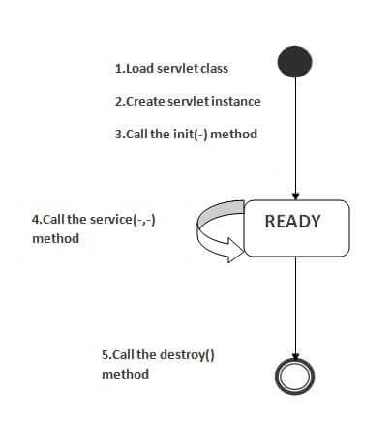
Servlet lifecycle
The web container maintains the life cycle of a servlet instance. Let's see the life cycle of the servlet:
Servlet class is loaded.
Servlet instance is created.
init method is invoked.
service method is invoked.
destroy method is invoked.
<number>

Slide 21
What is JSP?
JSP technology is used to create web application just like Servlet technology.
It can be thought of as an extension to Servlet because it provides more functionality than servlet such as expression language, JSTL, etc.
A JSP page consists of HTML tags and JSP tags.
The JSP pages are easier to maintain than Servlet because we can separate designing and development.
It provides some additional features such as Expression Language, Custom Tags, etc.
<number>

Slide 22
What is JSP?
It is a server side technology.
It is used for creating web application.
It is used to create dynamic web content.
In this JSP tags are used to insert JAVA code into HTML pages.
It is an advanced version of Servlet Technology.
It is a Web based technology helps us to create dynamic and platform independent web pages.
In this, Java code can be inserted in HTML/ XML pages or both.
JSP is first converted into servlet by JSP container before processing the client’s request.
<number>

Slide 23
Why JSP is better than Servlet?
JSP pages are more advantageous than Servlet:
They are easy to maintain.
No recompilation or redeployment is required.
JSP has access to entire API of JAVA .
JSP are extended version of Servlet.
<number>

Slide 24
Life Cycle of JSP pages
The JSP pages follow these phases:
Translation of JSP Page
Compilation of JSP Page
Classloading (the classloader loads class file)
Instantiation (Object of the Generated Servlet is created).
Initialization ( the container invokes jspInit() method).
Request processing ( the container invokes _jspService() method).
Destroy ( the container invokes jspDestroy() method).
Note: jspInit(), _jspService() and jspDestroy() are the life cycle methods of JSP.
<number>

Slide 25
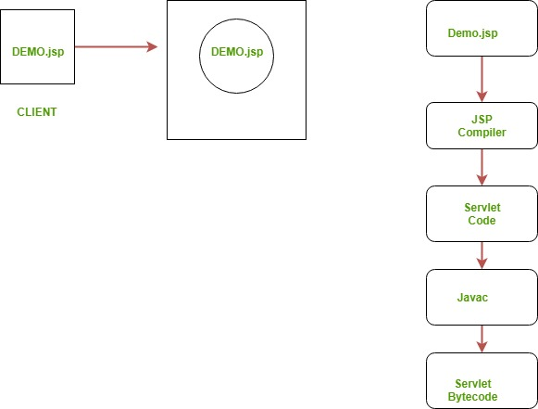
Life Cycle of JSP pages
<number>

Slide 26
JSP Syntax
Syntax available in JSP are following
Declaration Tag :- It is used to declare variables.
Syntax:-
<%! Dec var %>
Example:-
<%! int var=10; %>
Java Scriplets :- It allows us to add any number of JAVA code, variables and expressions.
Syntax:-
<% java code %>
<number>

Slide 27
JSP Syntax
JSP Expression :- It evaluates and convert the expression to a string.
Syntax:-
<%= expression %>
Example:-
<% num1 = num1+num2 %>
JAVA Comments :- It contains the text that is added for information which has to be ignored.
Syntax:-
<% -- JSP Comments %>
<number>

Slide 28
What is JSP?
It is a server side technology.
It is used for creating web application.
It is used to create dynamic web content.
In this JSP tags are used to insert JAVA code into HTML pages.
It is an advanced version of Servlet Technology.
It is a Web based technology helps us to create dynamic and platform independent web pages.
In this, Java code can be inserted in HTML/ XML pages or both.
JSP is first converted into servlet by JSP container before processing the client’s request.
<number>

Slide 29
Why JSP is better than Servlet?
JSP pages are more advantageous than Servlet:
They are easy to maintain.
No recompilation or redeployment is required.
JSP has access to entire API of JAVA .
JSP are extended version of Servlet.
JSP helps you decouple the implementation of the presentation logic (HTML code) and the business logic (Java code). You will be able to observe this difference when you write the same Hello World application using JSP.
<number>

Slide 30
Life Cycle of JSP pages
The JSP pages follow these phases:
Translation of JSP Page
Compilation of JSP Page
Classloading (the classloader loads class file)
Instantiation (Object of the Generated Servlet is created).
Initialization ( the container invokes jspInit() method).
Request processing ( the container invokes _jspService() method).
Destroy ( the container invokes jspDestroy() method).
Note: jspInit(), _jspService() and jspDestroy() are the life cycle methods of JSP.
<number>

Slide 31
Life Cycle of JSP pages
<number>

Slide 32
JSP Syntax
Syntax available in JSP are following
Declaration Tag :- It is used to declare variables.
Syntax:-
<%! Dec var %>
Example:-
<%! int var=10; %>
Java Scriplets :- It allows us to add any number of JAVA code, variables and expressions.
Syntax:-
<% java code %>
<number>

Slide 33
JSP Syntax
JSP Expression :- It evaluates and convert the expression to a string.
Syntax:-
<%= expression %>
Example:-
<% num1 = num1+num2 %>
JAVA Comments :- It contains the text that is added for information which has to be ignored.
Syntax:-
<% -- JSP Comments %>
<number>

Slide 34
#LifeKoKaroLift
Thank You!
<number>
23/05/19

